Slide 1
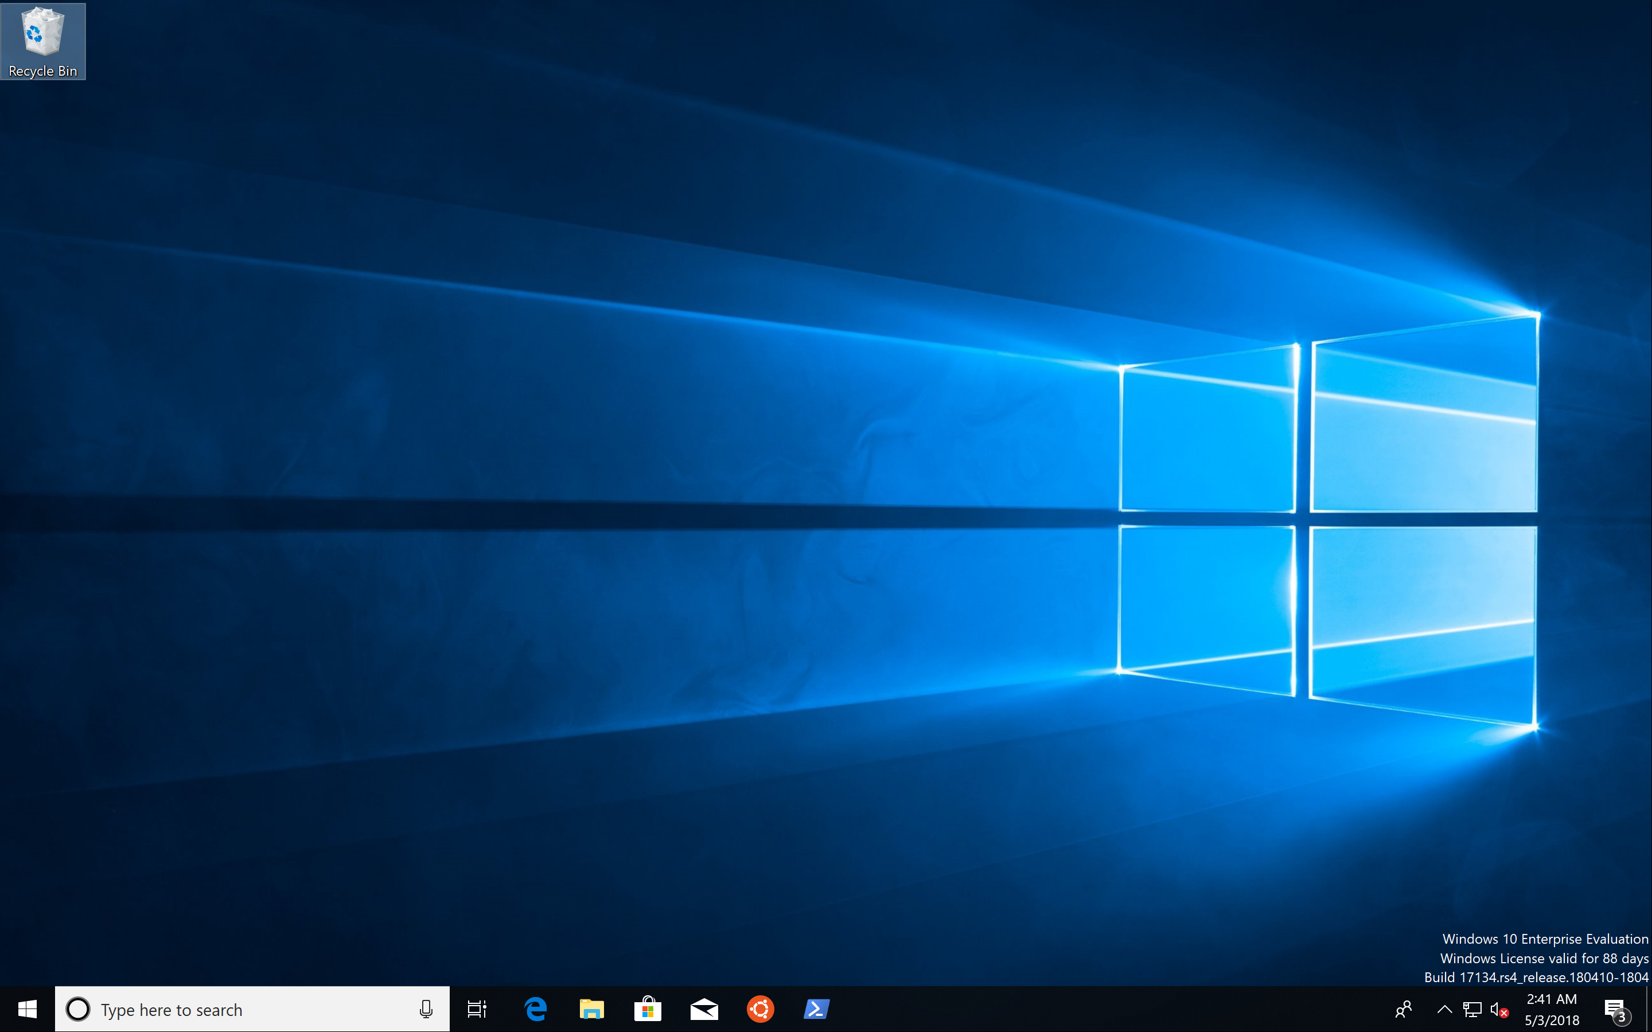
Setup a Dev environment that Feels like $HOME
Stefan Scherer, SEAL Systems AG

Slide 2
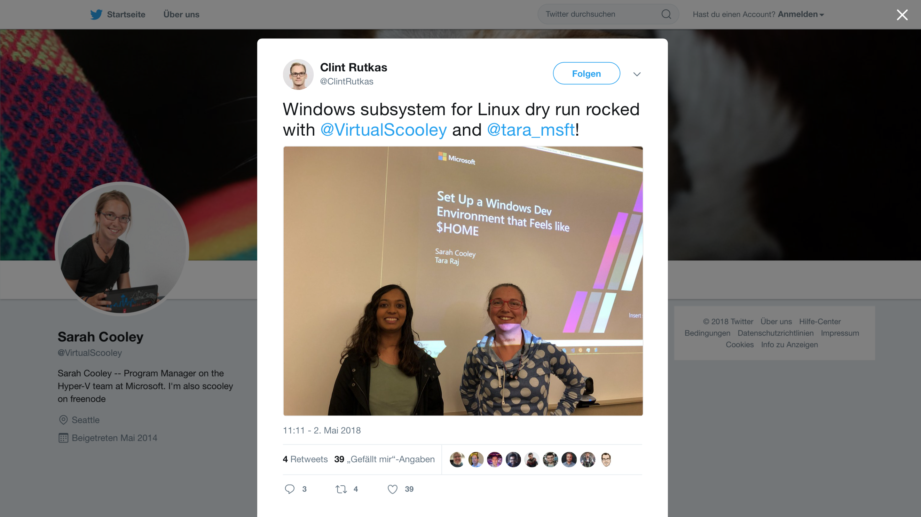
https://www.youtube.com/watch?v=Zi0eofqAkXU

Slide 3
Agenda
Windows 10
Choose your shell
Choose your editor
Vagrant
Docker
.dotfiles

Slide 4


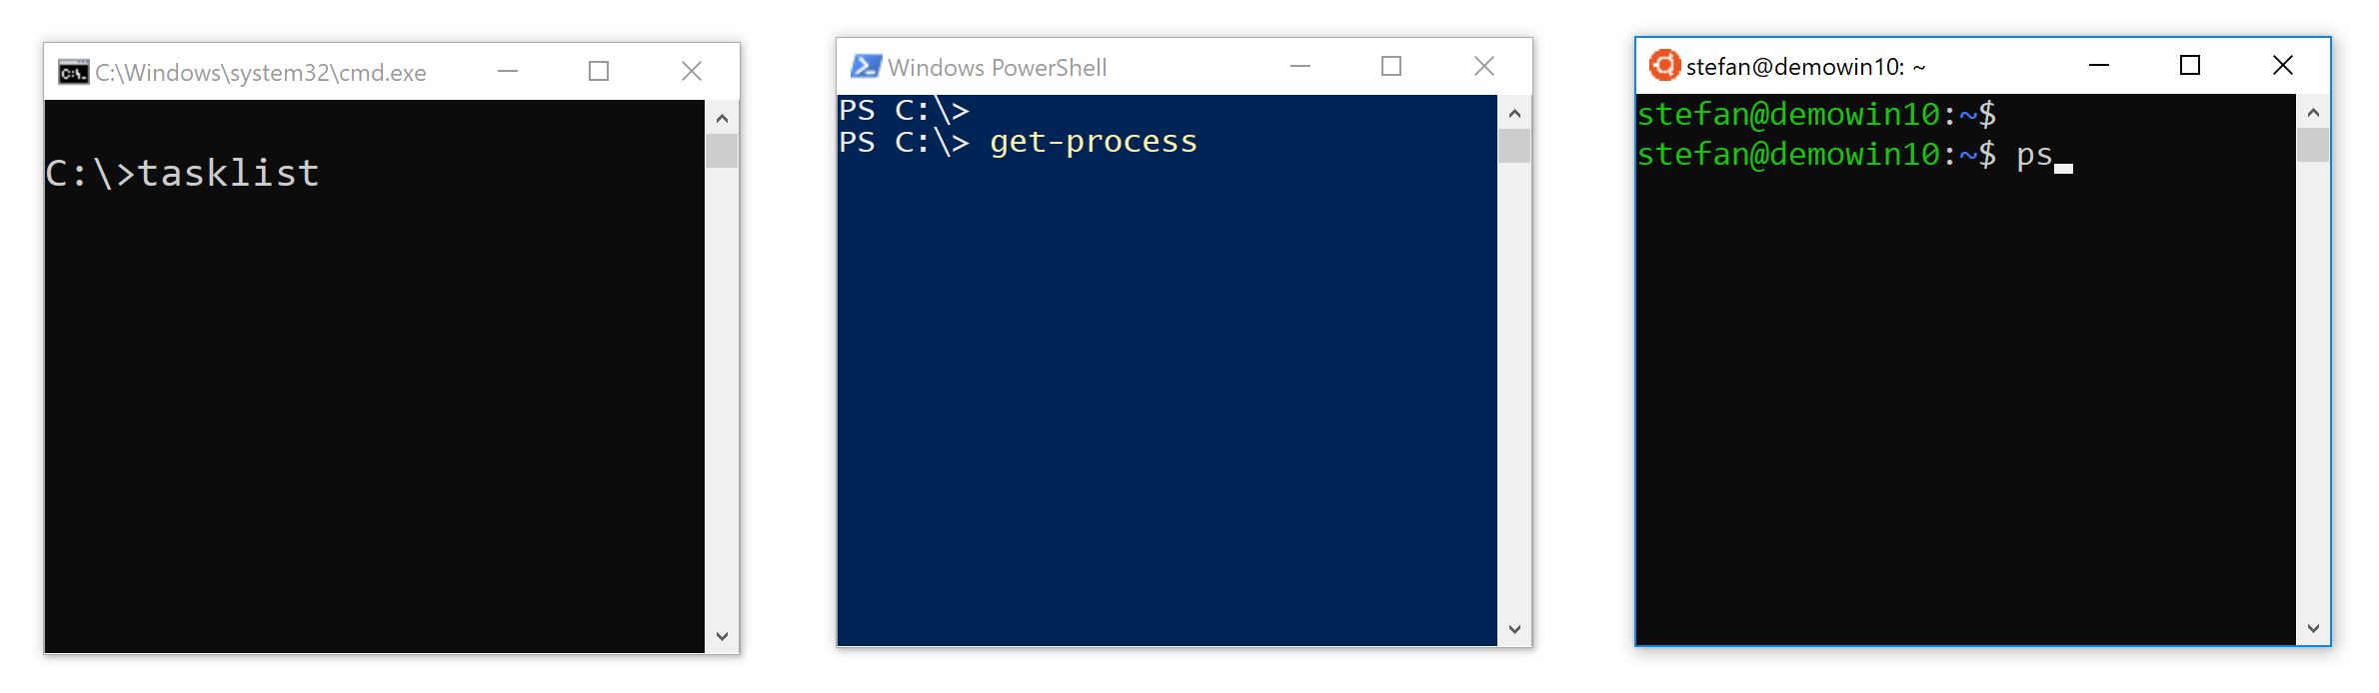
Choose your shell
CMD
PowerShell
bash

Slide 5


What is WSL?
Windows Subsystem for Linux
Run Linux binaries on Windows
Not just like Cygwin
Real ELF binaries, packages, ...

Slide 6
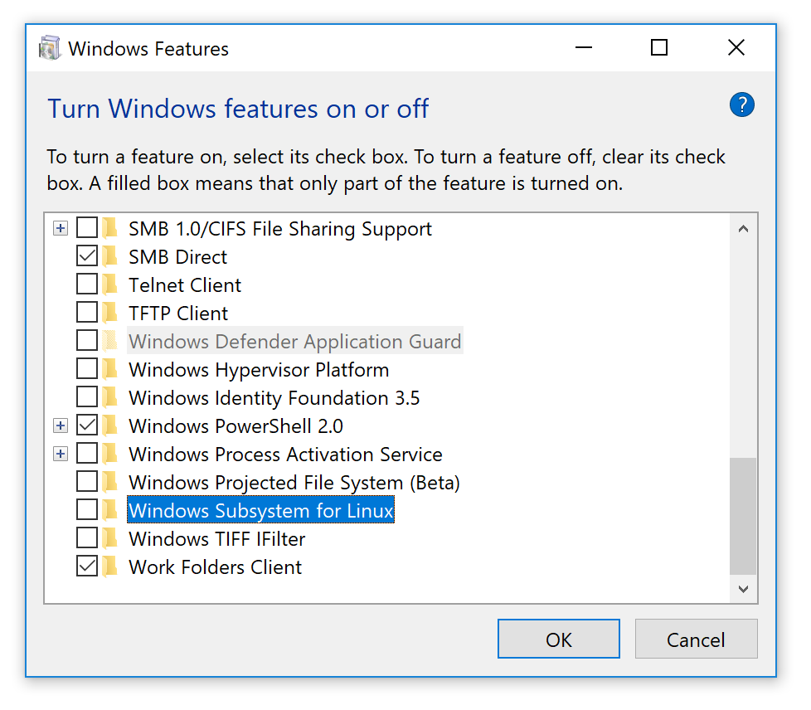
Install WSL
Open Control Panel
Turn Windows features on or off
Select Windows Subsystem for Linux
Open Admin PowerShell
Enable-WindowsOptionalFeature ` -Online –FeatureName ` Microsoft-Windows-Subsystem-Linux
Reboot

Slide 7
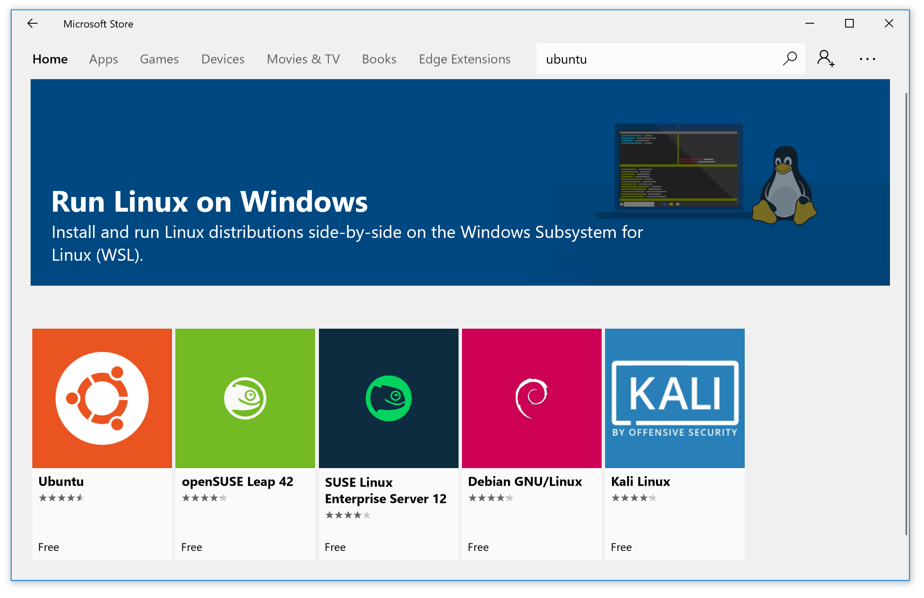

Slide 8
Install Ubuntu
https://www.microsoft.com/de-de/store/p/ubuntu/9nblggh4msv6

Slide 9
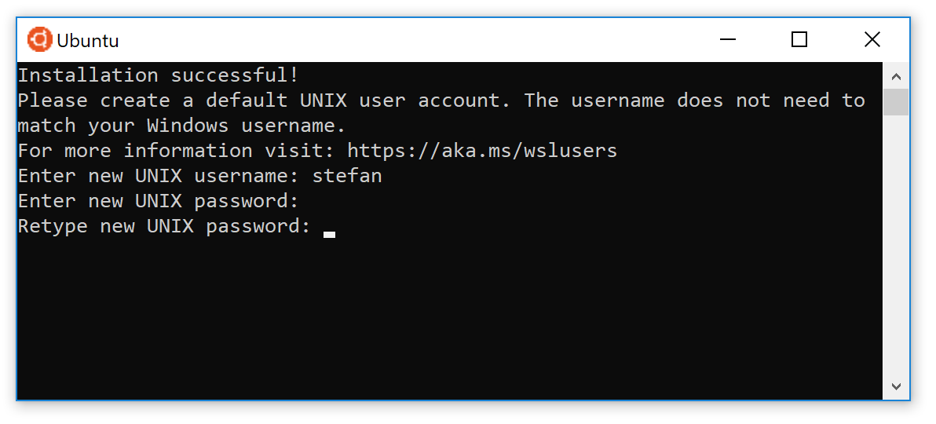
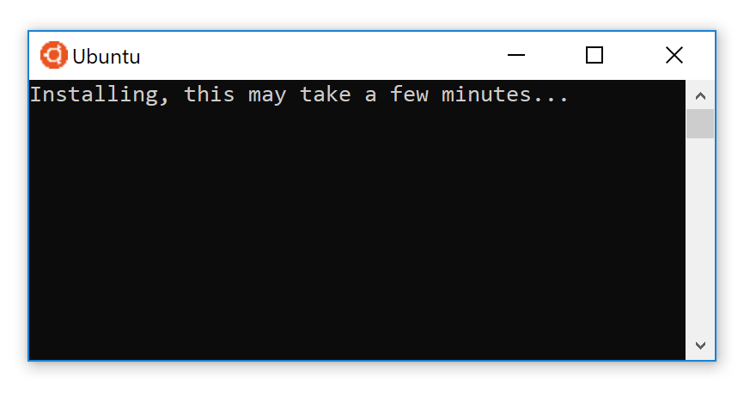
First Ubuntu shell

Slide 11
Editors
bash
git, ssh, ...
Files

Slide 12
Editors
bash
git, ssh, ...
Files
✔

Slide 13
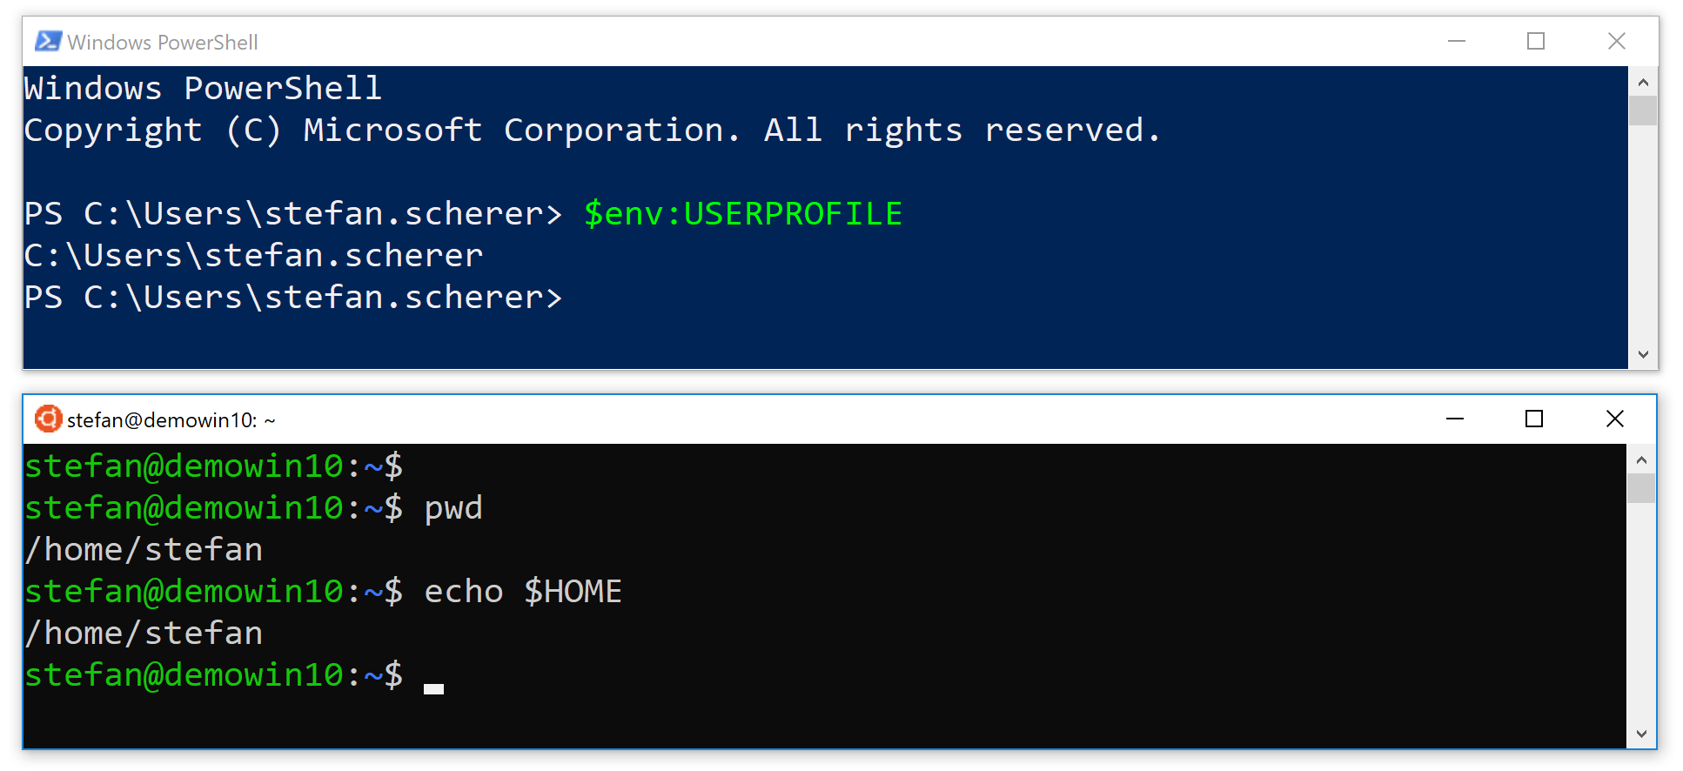
Feeling at $HOME?

Slide 14
Coming $HOME
sudo mkdir /Users
cd $HOME/..
windowsuser=$(cmd.exe /c echo %USERNAME% | tr -d '\r')
sudo cp -r $USER /Users/$windowsuser
sudo chown $USER:$USER /Users/$windowsuser
sudo sed -i "s,$HOME,/Users/$windowsuser," /etc/passwd
exit

Slide 15
Coming $HOME – the lazy way
curl https://stefanscherer.github.io/wsl/home.sh | sh

Slide 16
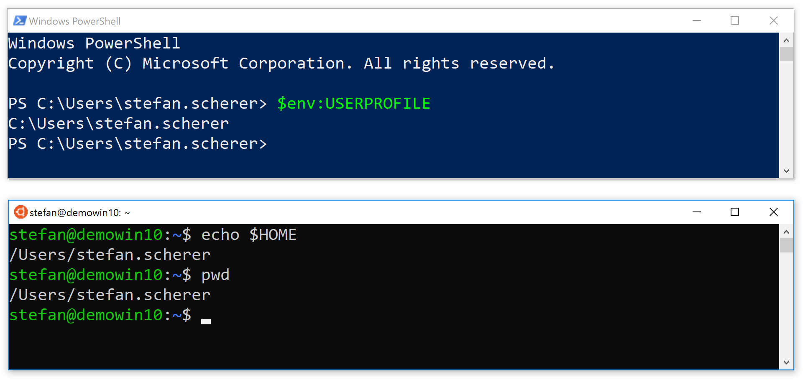
Feeling at $HOME!

Slide 17
Editors
bash
git, ssh, ...
Files
✔

Slide 18
Activate metadata for chmod/chown
sudo vi /etc/wsl.conf
[automount]
options = "metadata,umask=22,fmask=11,uid=1000,gid=1000"
Now close the bash terminal and start another Ubuntu shell.

Slide 19
Shared code folder
echo $HOME # -> eg. /Users/stefan.scherer
mkdir /mnt/c$HOME/code
ln -s /mnt/c$HOME/code $HOME/code
Now you can clone Git repos in WSL
And edit with Windows editors like Atom or VSCode

Slide 20
Install editors of choice
iwr -useb https://chocolatey.org/install.ps1 | iex
choco install -y atom
choco install -y visualstudiocode

Slide 21
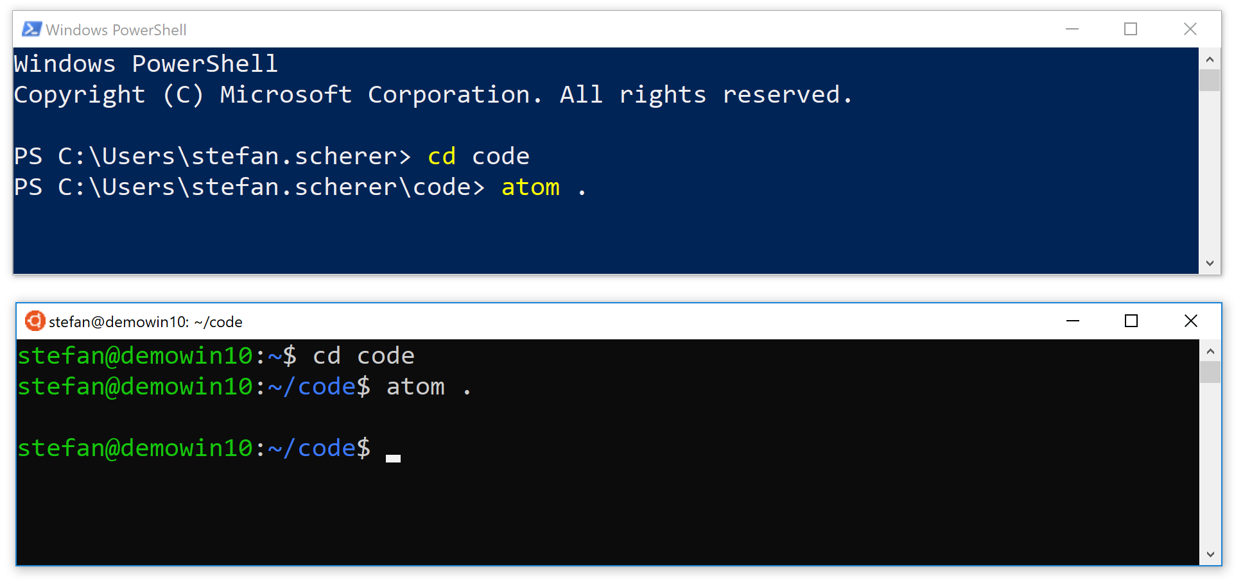
Happy coding

Slide 22



Slide 24
VMware Workstation
Vagrant VMware Utility
Vagrant
Vagrant VMware plugin
Other Vagrant plugins
some Patches ...

Slide 25
Install VMware and Vagrant utility
choco install -y vmwareworkstation
choco install -y vagrant-vmware-utility
Workaround for Vagrant 2.1.0: Add a symlink
mkdir \mnt\c\Users
cmd /c mklink /D \mnt\c\Users\$env:USERNAME `
\Users\$env:USERNAME

Slide 26
Prepare Windows – the lazy way
curl.exe https://stefanscherer.github.io/wsl/prep.ps1 | iex

Slide 27
Install Vagrant in WSL
mkdir -p /mnt/c$HOME/.vagrant.d
ln -s /mnt/c$HOME/.vagrant.d ~/.vagrant.d
sudo chown $USER:$USER ~/.vagrant.d
chmod 755 ~/.vagrant.d
wget https://releases.hashicorp.com/vagrant/2.1.0/vagrant_2.1.0_x86_64.deb
sudo dpkg -i vagrant_2.1.0_x86_64.deb
Add this to your ~/.bashrc export VAGRANT_WSL_ENABLE_WINDOWS_ACCESS=1

Slide 28
Prepare Vagrant VMware
sudo ln -s \
/mnt/c/ProgramData/HashiCorp/vagrant-vmware-desktop \
/opt/vagrant-vmware-desktop
vagrant plugin install vagrant-vmware-desktop
vagrant plugin license vagrant-vmware-desktop ./license.lic

Slide 29
Patch Vagrant 2.1.0 for VMware
wget https://raw.githubusercontent.com/StefanScherer/dotfiles/master/bin/vmrun.exe-helper
sudo cp vmrun.exe-helper '/usr/bin/C:\Program Files (x86)\VMware\VMware Workstation\vmrun.exe'
sudo ln -s '/usr/bin/C:\Program Files (x86)\VMware\VMware Workstation\vmrun.exe' /usr/bin/vmrun

Slide 30
Install Vagrant VMware – the lazy way
curl https://stefanscherer.github.io/wsl/vagrant.sh | sh

Slide 31
Run Vagrant boxes
cd ~/code
mkdir tst
vagrant init bento/ubuntu-18.04
vagrant up

Slide 32
Use shared folders
Bind mounts work in the Windows user‘s directory
Usable with the shared code folder
vagrant ssh
touch /vagrant/xxx
exit
ls xxx

Slide 33


Slide 35

VMware Workstation
docker-machine.exe
Docker Machine VMware plugin
Docker CLI
Docker Compose
some helpers ...

Slide 36
Install Docker Machine
choco install -y docker-machine
choco install -y docker-machine-vmwareworkstation

Slide 37
Install Docker CLI and Compose
curl https://get.docker.com | sh
curl -L https://github.com/docker/compose/releases/download/1.21.2/docker-compose-`uname -s`-`uname -m` -o docker-compose
chmod +x docker-compose
sudo mv docker-compose /usr/local/bin/docker-compose

Slide 38
Install Docker tools – the lazy way
curl https://stefanscherer.github.io/wsl/docker.sh | sh

Slide 39
Create a Docker Machine
docker-machine.exe create -d vmwareworkstation default

Slide 40
Switch to a Docker Machine
eval $(docker-machine.exe env --shell bash default | \
sed 's,\\,/,g' | sed 's,C:,/mnt/c,g')
docker version
dm default

Slide 41
Use bind mounts in Docker
Bind mounts work in the Windows user‘s directory
Usable with the shared code folder
cd ~/code
docker run -it -v $(pwd):/test ubuntu bash
touch /test/xxx
exit
ls xxx

Slide 42
Start and stop Docker Machine
docker-machine.exe start default
docker-machine.exe stop default
docker-machine.exe ls
dm
dm
dm

Slide 44
What are .dotfiles?
Save your .bashrc et al files in a GitHub repo
Restore them easily in your VM‘s or in WSL
Install looks like
cd ~/code
git clone https://github.com/StefanScherer/dotfiles
cd dotfiles && ./sync.sh

Slide 45
What are .dotfiles?
Aliases
z - "z foo" - cd to most frecent dir matching foo
.. - one dir up
... - two dirs up
.... - three dirs up
..... - four dirs up
dm start default Docker Machine shortcuts
dm default
dm stop default

Slide 46


Slide 47

Questions? Thank you!
Stefan Scherer @stefscherer

